Slide 1
Social Innovation & Inclusion of Sustainable Development Goals
FISE 1 PROJECT 2022
module 5 – Tuesday 8 November 2022

Slide 2
LEARNING OUTCOMES
to achieve greater awareness and knowledge
to analyse real-life projects
to prioritise
to synthesise
to listen
to be goal-oriented
to think outside the box
to delegate
to look at a problem from different perspectives
to tell stories
to think strategically
to observe
to adapt
to inspire

Slide 3
DEFINITION
Social innovation is a “novel solution to a social problem that is more effective, efficient, sustainable, or just than existing solutions and for which the value created accrues primarily to society as a whole rather than private individuals.”
Center for Social Innovation at the Stanford Graduate School of Business

Slide 4
COMMON EXAMPLES

Slide 5
OUR APPROACH

Slide 6
STAGE 1: WHAT SDG TO TACKLE? WHAT RESEARCH QUESTION?

Slide 8
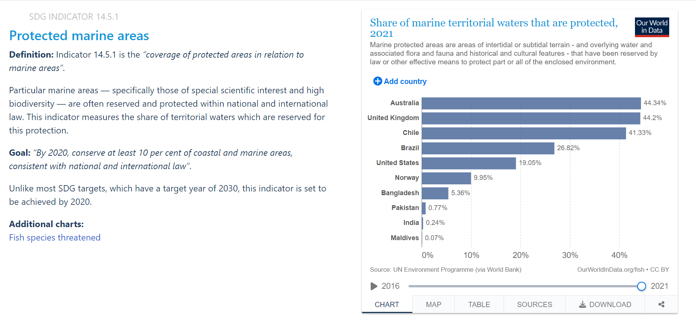
https://sdg-tracker.org/

Slide 9
STAGE 2: WHAT SOCIAL INNOVATION?
Explore and analyse a project that meets the challenge of a community-identified issue.

Slide 10
STAGE 3: COLLECTING INFORMATION
STAGE 4: ANALYSING INFORMATION
STAGE 5: ORGANISING INFORMATION
STAGE 6: GETTING PREPARED
STAGE 7: PRESENTING YOUR PROJECT

Slide 11
What you also need to know:
module starts Tuesday 22 November
oral presentations are due Tuesday 13 December
group distribution
group leader (weekly team meetings)
effective messages, visuals, postures, leadership, teamwork, co-operation, collaboration, task/time management, etc.
visual support: slide show, poster, both

Slide 12
C1 – C2
Team 1
MORVAN Antoine
PITON Lucie
TAMPE Marin
VIDAMENT Hugo
VIVIER Thibaut
Team 2
PARKER Noé
PROVOST Ylona
RONDONY Johanna
THUILLIER Théo
VERNHES Léon
Team 3
PICARD Louis-Marie
PICCO Amaury
SAVARIT Baptiste
TOSCAN DU PLANTIER Tea
Team 4
AGNUS Oscar
CASTANIER Mathieu
COROUGE Cédric
DENOEL Niels
HEDDE Rémy
Team 5
AGUIRRE Thomas
BERNANNOU Youssef
CHAURAND Charles
DELAS Rose
GAUTHIER Louis
Team 6
BEAU Clémentine
CHAMBREY Antoine
COMBES Lucas
DE KAT Gaëtan
GATTACCECA Livia
Team 7
DIEZ-LATTEUR Antoine
JACOBS Arne
LE BRIS Mathieu
LISSILLOUR Marie
MUCKENSTURM Victor
Team 8
GRISEL Raphaël
IVARS Léo
KERJOUAN Guillaume
LETOURNEUR Amélie
MICHEAU Camille
Team 9
IAMURRI Pierre
JAUGEY Romain
LABILLE Maaike
LE GENTIL Loan
MASSON Claire

Slide 13
C3 – C4
Team 10
LEBRERE Illyana
RAFFESTIN Thomas
STRUILLOU Julien
VOLATO SCUOTTO Chloé
Team 11
LOUIS Zacharie
RION Léa
TIHAMI OUAZZANI Main
VIANDIER Julien
Team 12
NAVILIAT Eloïse
PATRICOT Antoine
ROUVIERE Maxence
SELLIN Loann
TRAISNEL Simon
Team 13
ADAMCZAK Maëlys
BERTRAND Antoine
CASSAGNE Mathis
GILLIER Alban
LANGLE Benjamin
Team 14
AYYADA Samy-William
BOURSTIN Adèle
BROWN Félicien
EYMOND Maëlys
GBIKPI Christian-Joël
Team 15
BALTHAZAR Antonin
BARBARIT-GABORIAU Simon
BRU Adrien
FLEURIAULT Emmanuel
Team 16
FRANÇAIS Pierre
GOURMELON Sébastien
LEGA Alexandre
NEVEU Isabelle
REMUSAT Stanislas
Team 17
FRANÇOIS Nicolas
GARNIER Tristan
LANASPEZE Arthur
MUSY Matthieu
QUIBEL Clément
Team 18
FROUIN Edern
GUIVARCH Baptiste
LAURENT-IRANMEHR Zoé
MOTRET Julie
PATRIZIO Clément

Slide 14
C5 – C6
Team 19
COURAUD Gabin
FOUGERAY Benjamin
KINTZINGER Marie
LABADI Arthur
LEOST Titouan
Team 20
DENTZER Zéphyr
EDOUARD Thibault
GUYOT Alice
LA PIANA Eliot
LE RIGUER Erwan
Team 21
DUPUIS Romain
GRESSER Vincent
JOUVET Laura
KOWALSKI Alexandre
LAPIE Louise
Team 22
ARGHIR Andréa
BERTHET Jeanne
CHAUCHADIS Gaël
COULMY Antoine
GANTIN Johan
Team 23
AYGALENQ Alexis
BEREZECKI Marius
BOUTIN Marie
CLOAREC-RIOUAT Nicolas
DERMOUCHE Alexandre
Team 24
BEART Gabriel
BORNIER Romain
BUVAT Mathilde
CHOPIN Eliott
DANET Enora
Team 25
DUPUY Hadrien
MELIN David
MOURGUES Maxime
ROBERT Thomas
SOUCAILLE Matti
Team 26
LERAY Ewen
MOLLARD Basile
MONIN Alexandre
PRATABUY-TRAN-QUANG Lucie
RICOUARD Ambre
Team 27
MAINKA Elise
MAISANI Cyril
MORIVAL Rémi
RENAZE Cyril

Slide 15
C7 – C8
Team 28
BUCHHEIT Guillaume
CORVISY Virgil
DUGUE Gabriel
FELCE Anthony
LEFEBVRE Eloi
Team 29
CALVIER Tiphaine
CORNILLE Martin
DERIU PERALDI Joseph
FAURY Juliette
GARYGA Eliott
Team 30
CLEMENT Lancelot
DALIGAULT Celian
DRILHON Matthieu
DUMONT Colin
FONDO Matthieu
Team 31
ACCHIARDI Adrien
AL HASNE Mohammed-Amine
BARRERE Nicolas
BONNA Marion
BOUYAD Yassin
Team 32
ADAM Baptiste
ALRAN Mattéo
ANDRIANARIVONY Harena
BENALI Aksil
BESNARD Zoé
Team 33
AGNES Alix
AHTITICH Elias
AUFFRET-WIENER Marie
BENSAADA Idriss
Team 34
GRANZOTTO Rémi
LE CAM Louis
MASCARO Siam
ORVEILLON Maurine
SANCHEZ Eva
Team 35
JACQUET Auxane
KREBS Eva
LUBERNE Nicolas
MERCEUR Benoît
RUAUD Brieuc
Team 36
KARAMI Armand
LLOPIS Théo
MARTINEAU Simon
MASCRE Alban
RESTOUT Jean-Baptiste

